Slide 1

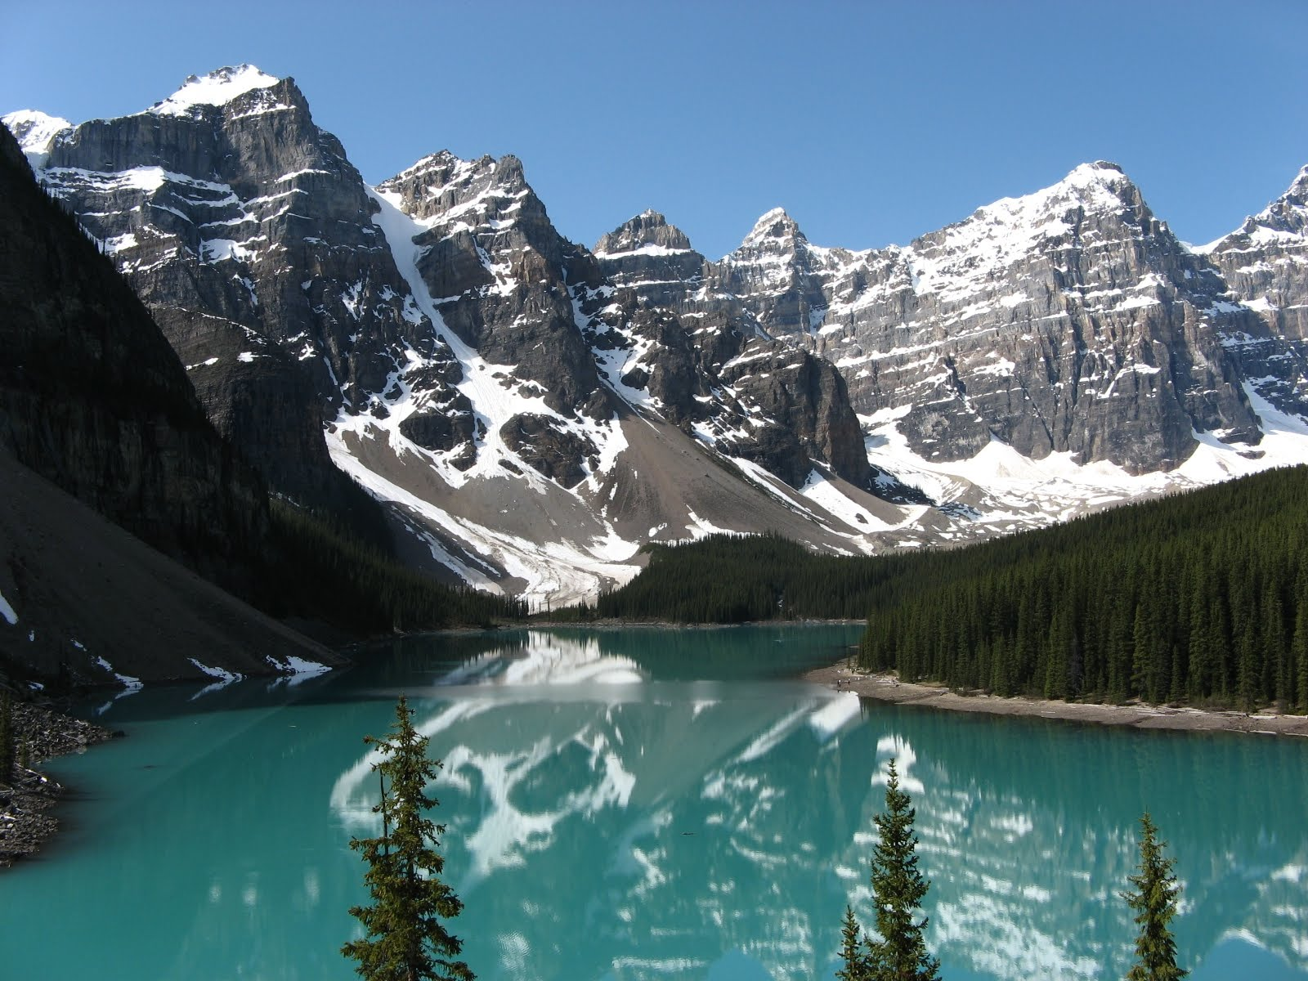
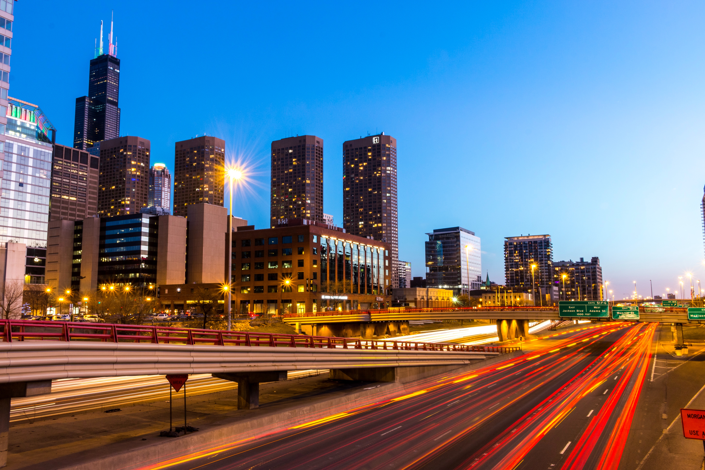
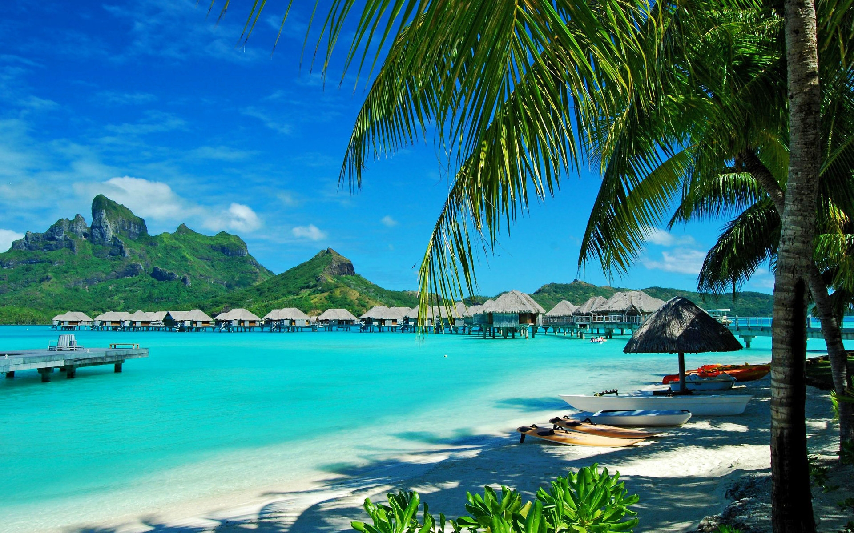
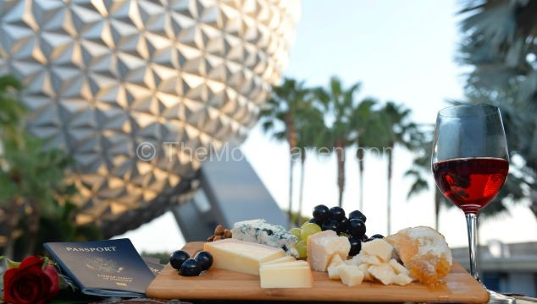
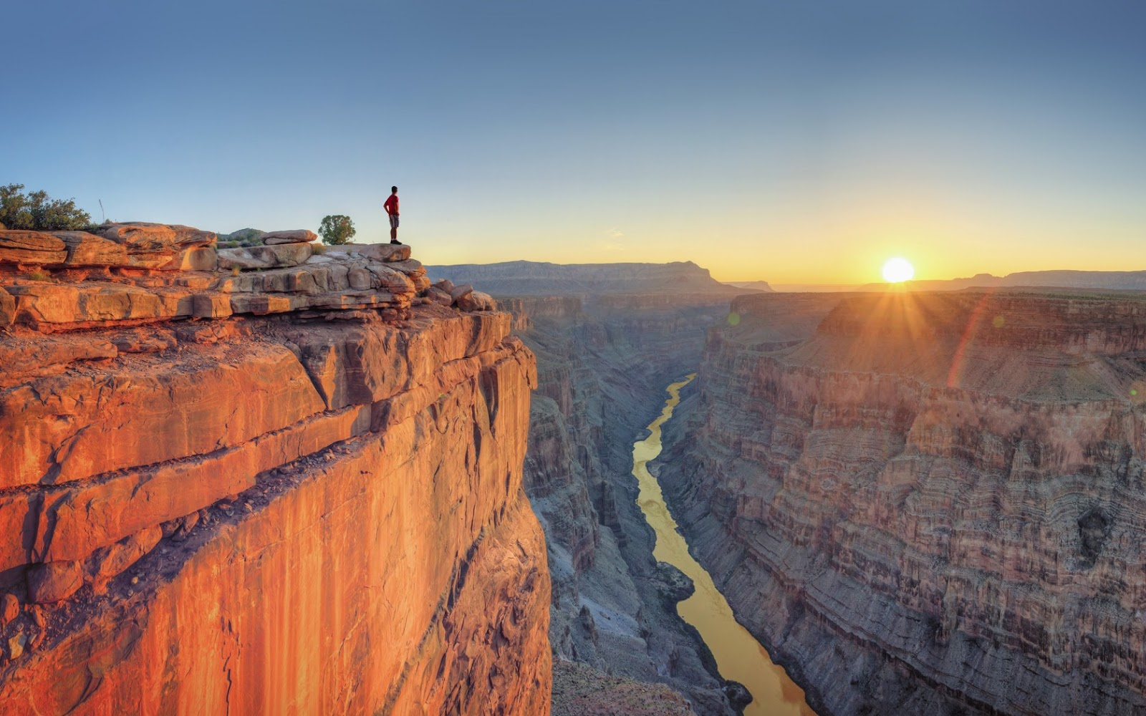
VACATION TIME!!! Where should we go once the COVID-19 quarantine is over?
This Photo by Unknown Author is licensed under CC BY-NC-ND
This Photo by Unknown Author is licensed under CC BY-NC-ND
Chris Ladymon
Jennifer Garnett
Blake Wilfong
Ben fox
This Photo by Unknown Author is licensed under CC BY-NC-ND
This Photo by Unknown Author is licensed under CC BY-ND

Slide 2

Overview: I NEED TO GET OUT OF HERE!!!!
Where should I go on vacation? Why?
30 best places in the US to go on Vacation- US News travel “Best Places to Visit in the USA”.
Great Food?- Google- API
Great Attractions?- Google- API
Crime Rates- bestplaces.net/crime
This Photo by Unknown Author is licensed under CC BY-SA

Slide 3
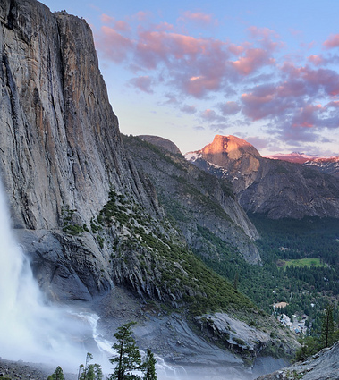
Data Set
30 locations
Lat, Long pulled from google maps search
Crime rate data- Normalized for population differences; Scale 1-100
Average restaurant rating within a 20mi radius of the vacation spot.
Average Attraction rating within a 20mi radius of the vacation spot
This Photo by Unknown Author is licensed under CC BY-SA-NC

Slide 4
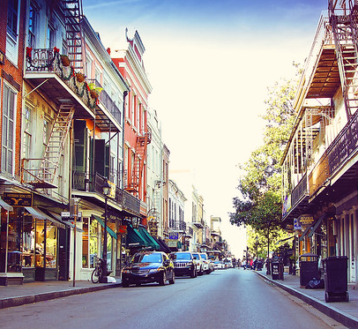
Logistics:
Python API- google maps API using pandas data frames
View 1
View 2
View 3
This Photo by Unknown Author is licensed under CC BY-NC-ND

Slide 5
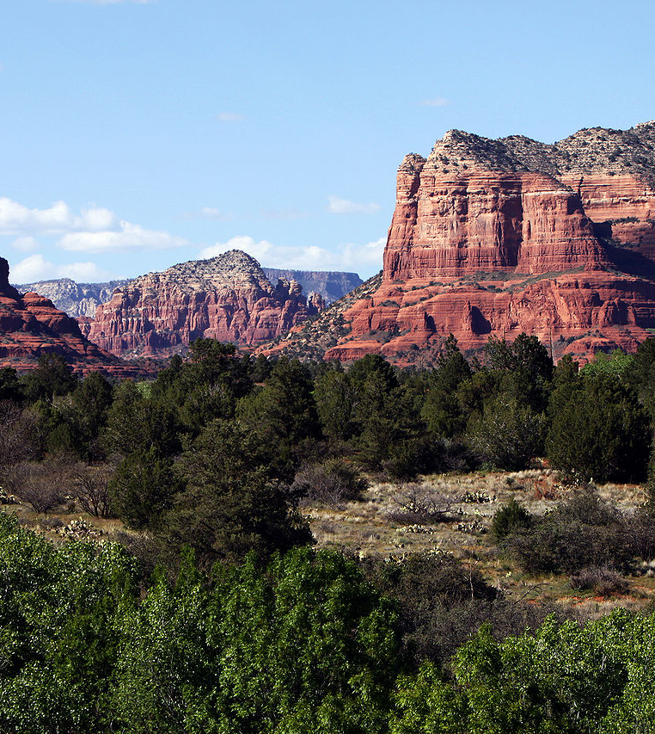
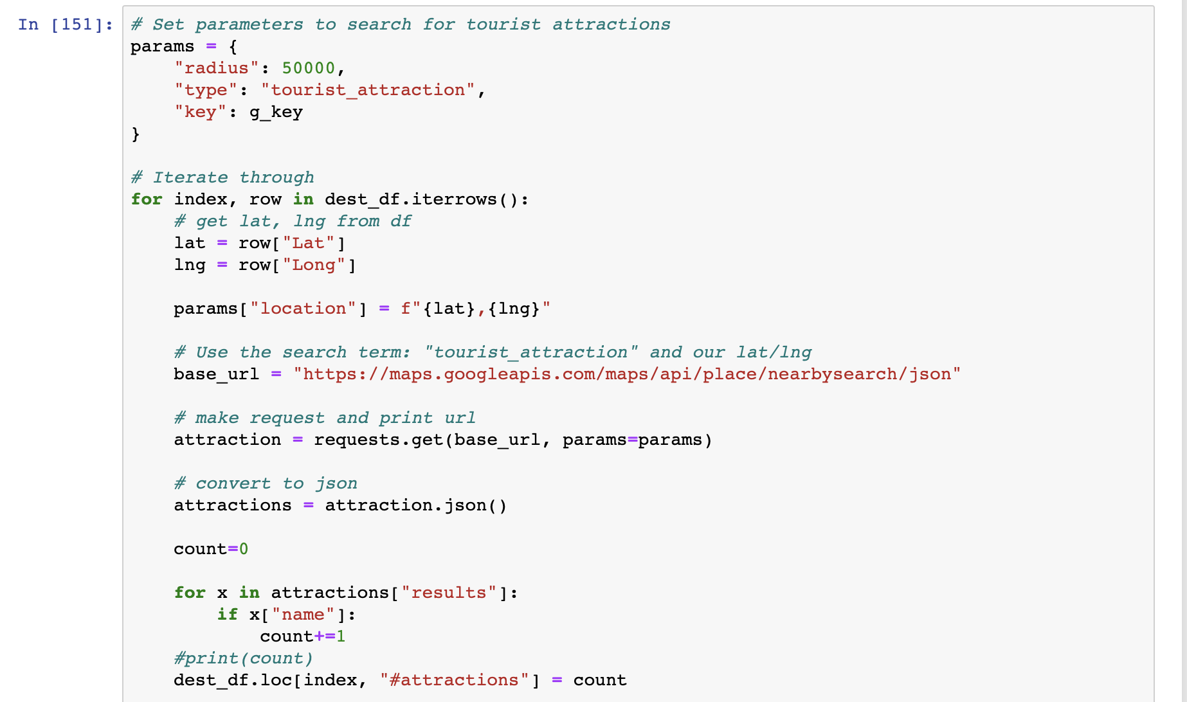
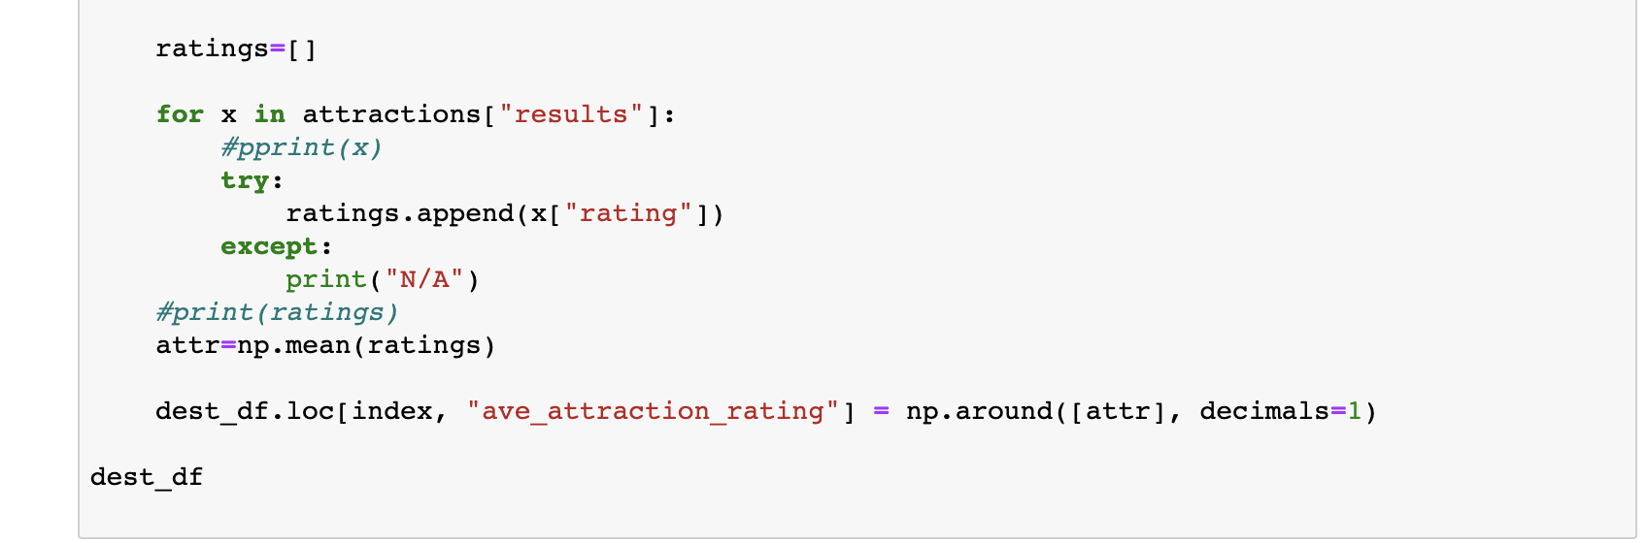
Sample Data Code:
This Photo by Unknown Author is licensed under CC BY-SA

Slide 6
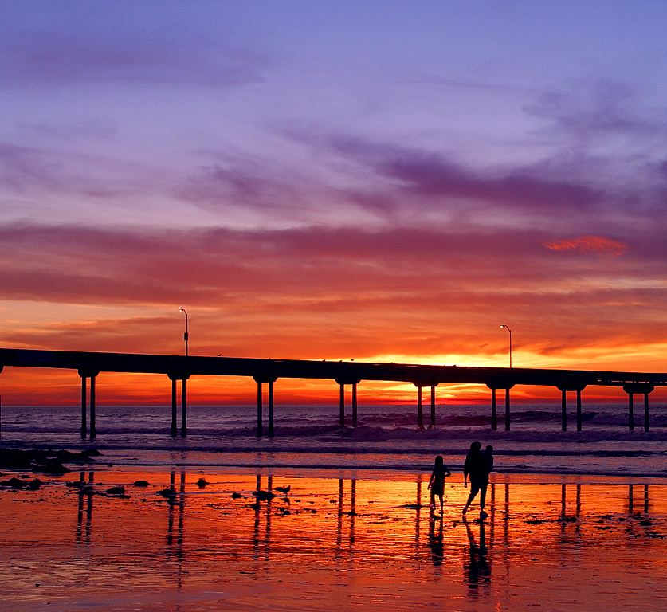
Visualizations:
This Photo by Unknown Author is licensed under CC BY-SA

Slide 7
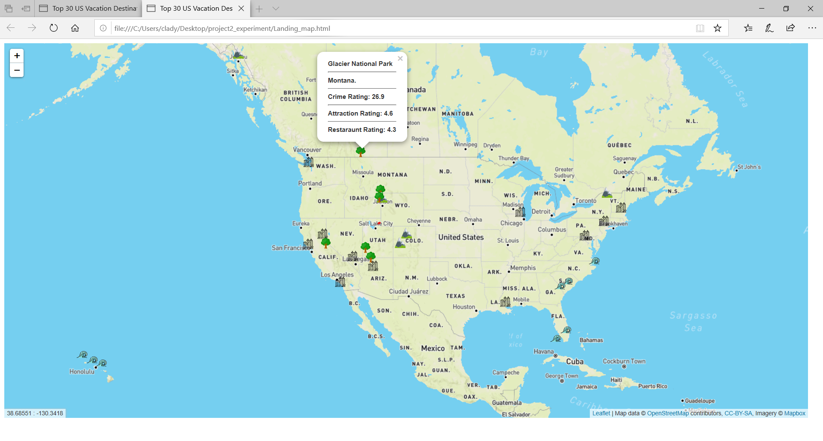
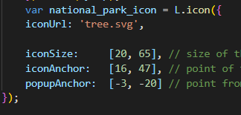
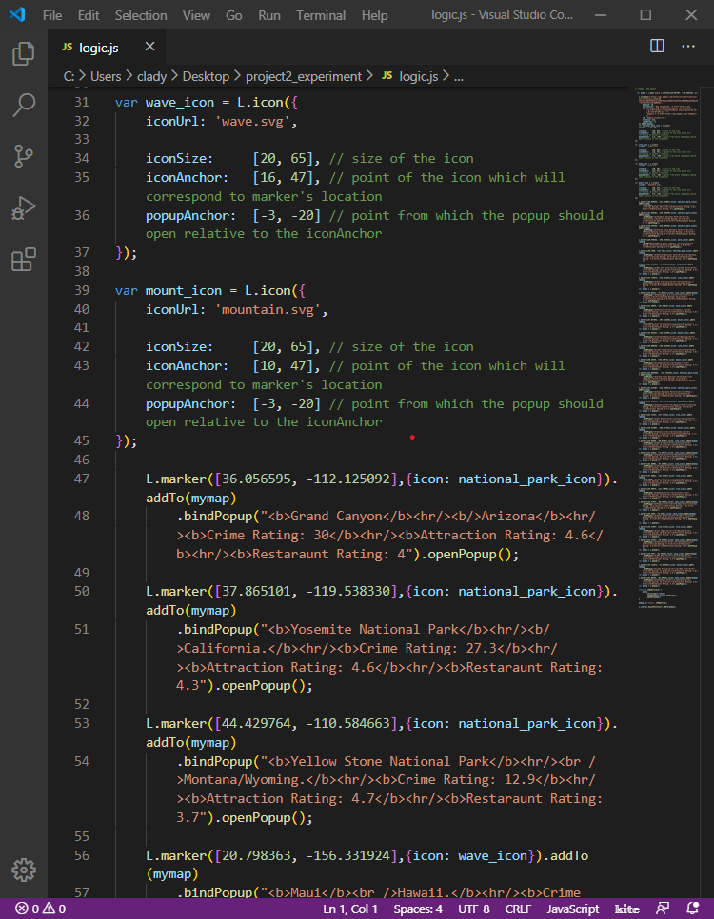
Mapping The Locations
Icons retrieved from Flaticon.com
Cursor Position Plugin

Slide 8
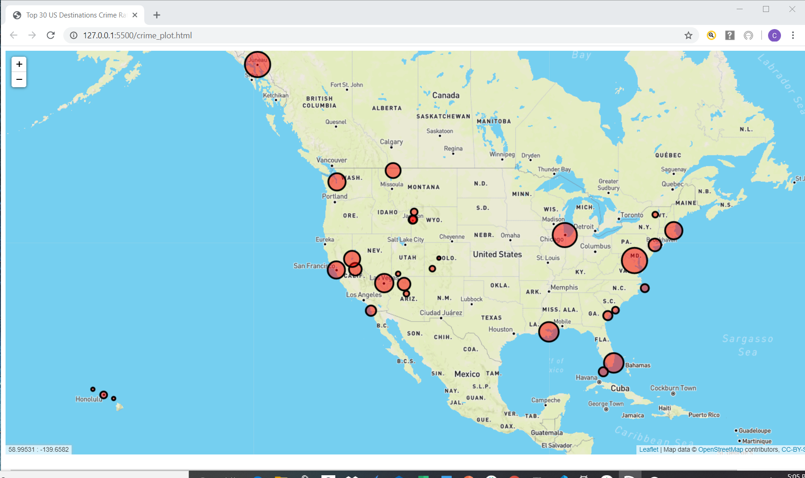
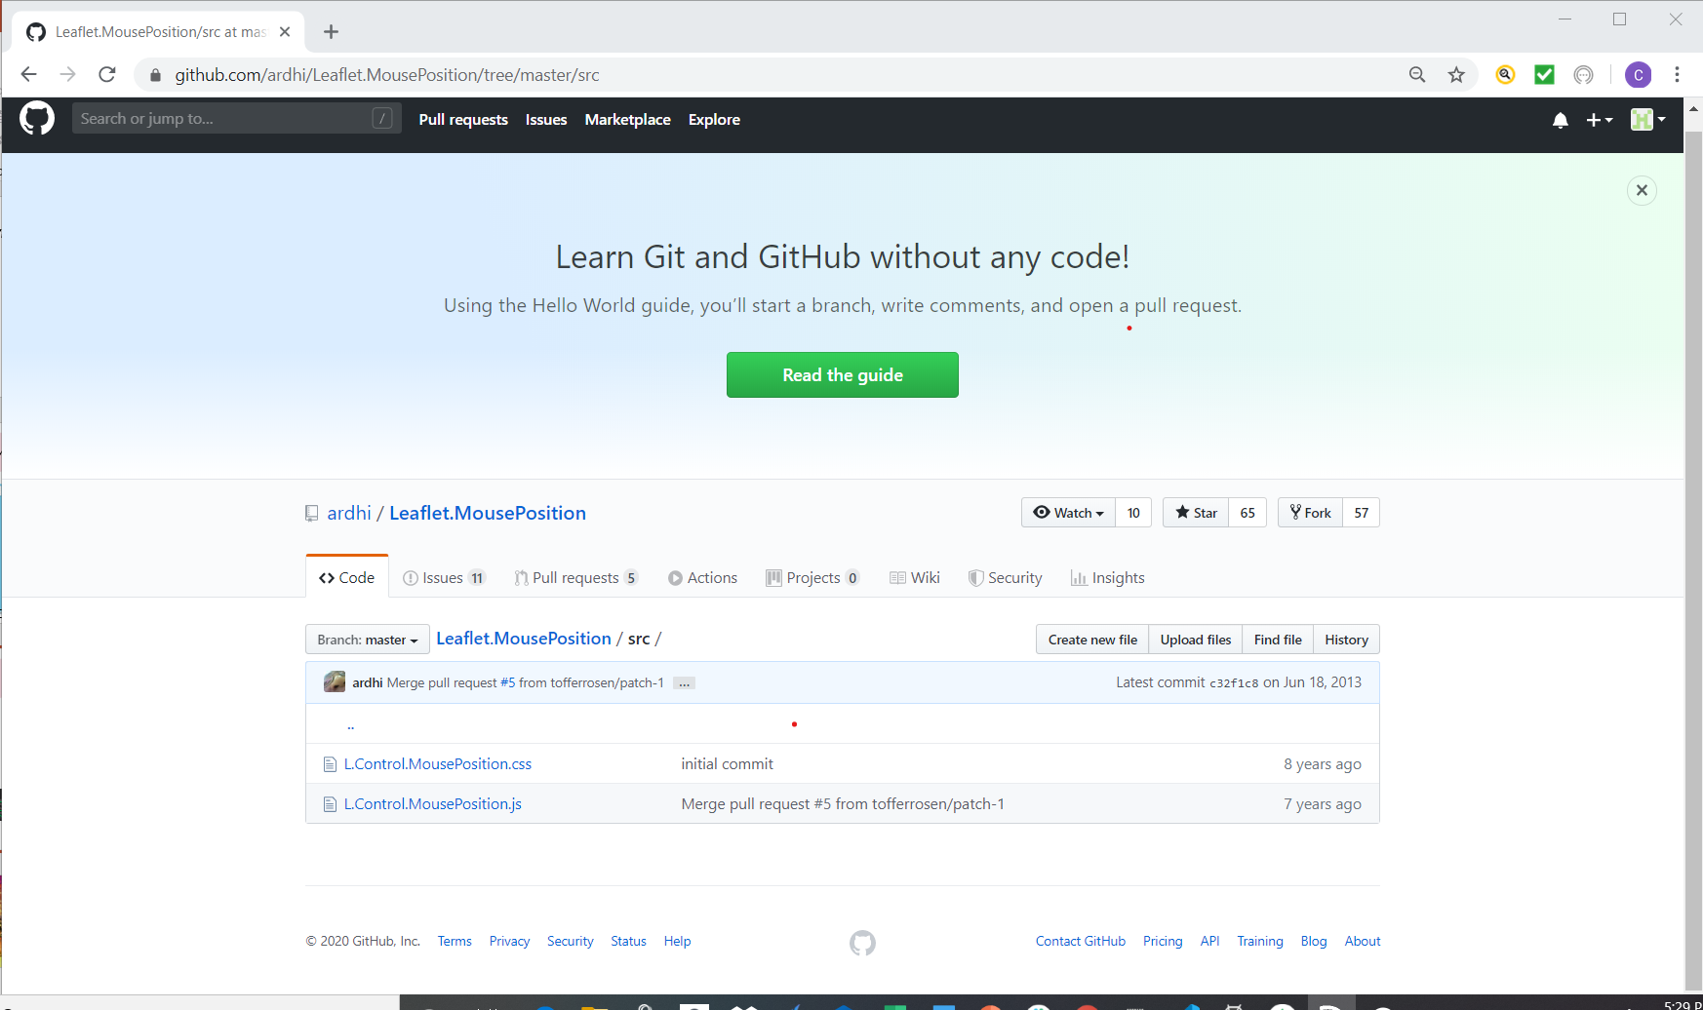
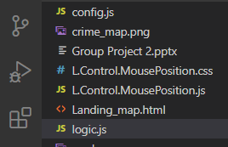
Crime Map and Plugin
Circles magnitude driven by crime rating

Slide 9
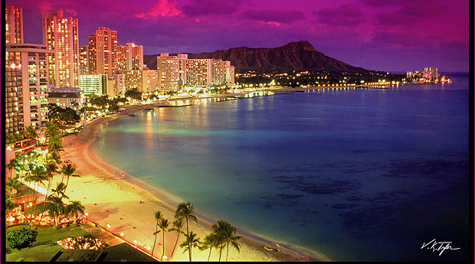
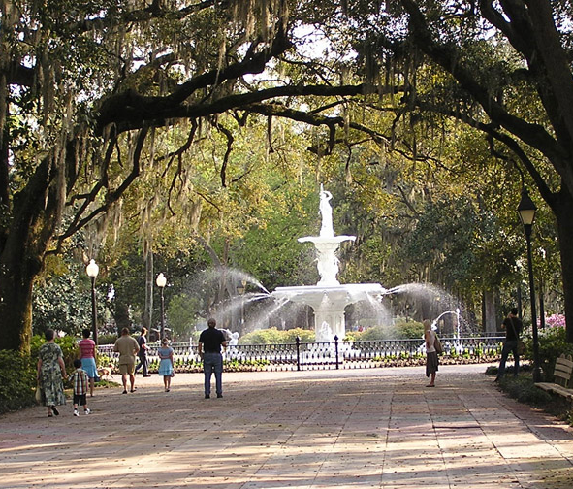
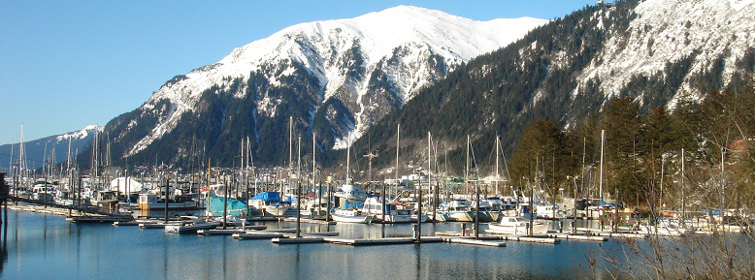
SOOOOO……WHERE WE GOIN’ NEXT?
Thank you!!!!
This Photo by Unknown Author is licensed under CC BY-NC
This Photo by Unknown Author is licensed under CC BY-SA
This Photo by Unknown Author is licensed under CC BY-SA

